Slide 1
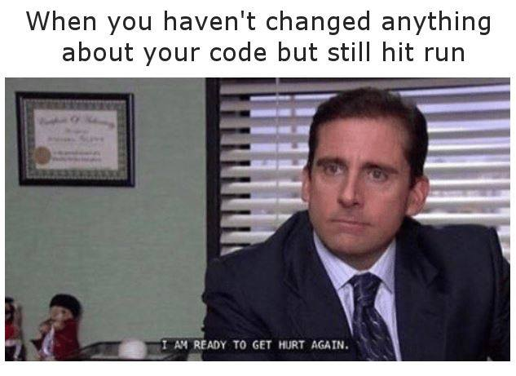

Slide 2
Functions
CS2308
Gentry Atkinson

Slide 3
Mathematical Foundation
Algebraic Function
f(x) = 2x + 2
Input: x
Output: 2x+2
Example:
f(2) = 2*2 + 2
= 6
C++ Function
int f(int x){
  return 2*x + 2;
}
Input: int x
Output: 2*x+2
Example:
            f(3) = 2*3 + 2
                = 8

Slide 4
C++ Functions
Define a relationship between inputs (parameters) and outputs (return statement).
Every function returns one or zero values.
A function can have any number of inputs.
We must give a datatype for every input and output.

Slide 5
Example 1
int double_int (int x){
return 2*x;
}
int main(int argc, char** argv){
cout << "2 * 2 is " << double_int(2) << endl;
} //try to predict the output

Slide 6
Function Returns
Functions can have several return statements but will only return one value.
Functions that do not return a value have the return type “void”.

Slide 7
Example 2
int foo(int a){
if (a < 2)
return 0;
else if (a < 10)
return 5*a;
else
return a/10;
}
int main(int argc, char** argv){
cout << "foo(a) is " << foo(2) << endl;
} //try to predict the output

Slide 8
Parameters vs. Arguments
Parameters: variables that are created as part of a function definition.
Arguments: variables or literals that are “passed to” a function call.
The const keyword can be used to keep a function from changing the value of its parameters.

Slide 9
Example 3
void foo(string param){
cout << "param was passed" << param << endl;
return;
}
int main(int argc, char** argv){
cout << "calling foo with the argument \"bar\"\n";
foo("bar");
return 0;
} //try to predict the output

Slide 10
Scope
Scope: the portion of a program where a variable can be legally referenced.
In general, variables are only “in scope” in the {block of code} that they were created in.
Variables might still be in memory even when they are not in scope.
3 Levels of scope:
  Global
  Function
  Block

Slide 11
Example 4
void foo(){
int a = 3;
cout << "a in foo is " << a << endl;
return;
}
int main(int argc, char** argv){
int a = 2;
cout << "a in main is " << a << endl;
foo();
return 0;
} //try to predict the output

Slide 12
Function Prototypes
Adding many function definitions to a program can make the main function hard to find.
To avoid this, we can use function prototypes to “warn” the compiler that a function will be used before it is defined.
Prototype parameters do not have to have names.

Slide 13
Example 5
void foo(int);
int main(int argc, char** argv){
cout << "Calling foo with argument 2" << endl;
foo(2);
return 0;
} //try to predict the output
void foo(int a){
cout << "foo passed " << a << endl;
return;
}//try to predict the output

Slide 14
Questions or Comments?

